Slide 1

CSE- 104
Structured Programming Lab
Lab : 06 Mini Lab Test + Strings
Fahad Ahmed
Lecturer, Dept. of CSE
E-mail: fahadahmed@uap-bd.edu

Slide 2
Strings in C
Strings are actually one-dimensional array of characters terminated by a null character '\0'. Thus a null-terminated string contains the characters that comprise the string followed by a null.
When the compiler encounters a sequence of characters enclosed in the double quotation marks, it appends a null character \0 at the end by default.
How to declare a string?
Here's how you can declare strings:
char s[5];
char c[ ] = “Hellow";

Slide 3
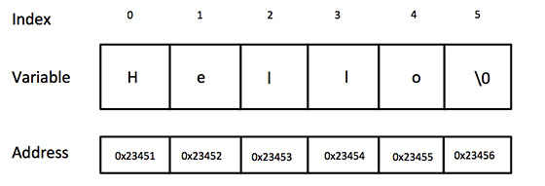
Strings in C
char c[ ] = “Hello";

Slide 4
Strings in C
How to initialize strings?
You can initialize strings in a number of ways.
char c[] = "abcd";
char c[50] = "abcd";
char c[] = {'a', 'b', 'c', 'd', '\0'};
char c[5] = {'a', 'b', 'c', 'd', '\0'};

Slide 5
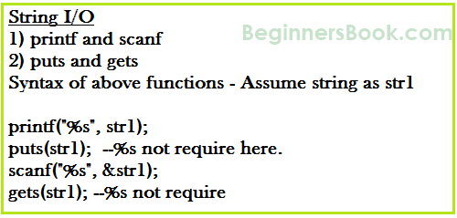
Strings in C
String I/O in C programming
puts() vs printf() and gets() vs fgets()
https://www.geeksforgeeks.org/puts-vs-printf-for-printing-a-string/

Slide 6
Strings in C
C program to illustrate strings
#include<stdio.h>
int main()
{
char str[] = "hello";
printf("%s",str);
return 0;
}

Slide 7
Strings in C
Read String from the user
You can use the scanf() function to read a string.
The scanf() function reads the sequence of characters until it encounters whitespace (space, newline, tab, etc.).

Slide 8
Strings in C
String Input: Read a String
Problem:
Write a c program to input your own name and print this.

Slide 9
Strings in C
String Input: Read a String
#include <stdio.h>
int main()
{
char name[20];
printf("Enter name: ");
scanf("%s", name);
printf("Your name is %s.", name);
return 0;
}

Slide 10
Strings in C
String Input: Read a String : with space
#include <stdio.h>
int main()
{
char name[30];
printf("Enter name: ");
//fgets(name, sizeof(name), stdin); // read string
gets(name); // read string
printf("Name: ");
puts(name); // display string
printf("\n\nYour name is %s.", name);
return 0;
}
gets() is risky to use!
it suffers from Buffer Overflow

Slide 11
Strings in C
String Input: Read a String :gets(), fgets()
#include <stdio.h>
int main()
{
char name[10];
printf("Enter name: ");
gets(name); // read string
printf("\nYour name is %s.", name);
return 0;
}
#include <stdio.h>
#define size 10
int main()
{
char name[size];
printf("Enter name: ");
fgets(name, size, stdin);
printf("\nYour name is %s.", name);
return 0;
}

Slide 12
Strings in C
Passing string to a Function
#include <stdio.h>
#define size 30
void displayString(char str[])
{
printf("String Output from function: ");
puts(str);
}
int main()
{
char str[size];
printf("Enter string: ");
fgets(str, size, stdin);
displayString(str); // Passing string to a function.
return 0;
}

Slide 13
Strings in C
Find the length of a string
Write a program in C to find the length of a string without using library function
Input :
structured programming in c
Expected Output :
Length of the string is : 15

Slide 14
Strings in C
Find the length of a string
#include <stdio.h>
#define size 30
int main()
{
char str[size];
int i;
printf("\nInput the string : ");
gets(str);
for (i = 0; str[i] != '\0'; ++i);
printf("Length of the string is : %d\n\n", i);
}

Slide 15
Strings in C
Find the Frequency of a Character
Enter a string: Fahad Ahmed
Enter a character to find its frequency: a
Frequency of a = 3

Slide 16
Strings in C
Find the Frequency of a Character
#include <stdio.h>
#define size 30
int main()
{
char str[size], ch;
int cnt = 0,i;
printf("Enter a string: ");
//fgets(str, size, stdin);
gets(str);
printf("Enter a character to find its frequency: ");
scanf("%c", &ch);
for (int i = 0; str[i] != '\0'; i++)
{
if (ch == str[i])
cnt++;
}
printf("Frequency of %c = %d", ch, cnt);
return 0;
}

Slide 17
Class Performance Strings in C
Reverse of a string
Write a program in C to reverse a string without using library function
Input :
structured programming in c
Expected Output :
c ni gnimmargorp derutcurts

Slide 18
Strings in C
Find the length of a string
#include <stdio.h>
#define size 30
int main()
{
char str[size];
int i;
printf("\nInput the string : ");
gets(str);
for (i = 0; str[i] != '\0'; ++i);
printf("Length of the string is : %d\n\n", i);
}

Slide 19
Strings in C
#include <stdio.h>
int main()
{
char s[1000], r[1000];
int begin, end, count = 0;
printf("Input a string\n");
gets(s);
while (s[count] != '\0')
count++;
end = count - 1;
for (begin = 0; begin < count; begin++)
{
r[begin] = s[end];
end--;
}
r[begin] = '\0';
printf("%s\n", r);
return 0;
}

Slide 20
Strings in C
C program to check if a number is palindrome or not
Input :
abccba
abccba
Expected Output : palindrome

Slide 21
Strings in C
#include <stdio.h>
int main()
{
int n, r = 0, t;
printf("Enter an integer to check if it's palindrome or not\n");
scanf("%d", &n);
t = n;
while (t != 0)
{
r = r * 10;
r = r + t%10;
t = t/10;
}
if (n == r)
printf("%d is a palindrome number.\n", n);
else
printf("%d isn't a palindrome number.\n", n);
return 0;
}

Slide 22
Strings in C
C program for palindrome without using string functions
Input :
str[] = a b c d d c b a
rev[]= a b c d d c b a
Expected Output : palindrome

Slide 23
Strings in C
#include <stdio.h>
int main()
{
char text[100];
int begin, middle, end, length = 0;
gets(text);
while (text[length] != '\0')
length++;
end = length - 1;
middle = length/2;
for (begin = 0; begin < middle; begin++)
{
if (text[begin] != text[end])
{
printf("Not a palindrome.\n");
break;
}
end--;
}
if (begin == middle)
printf("Palindrome.\n");
return 0;
}

Slide 24
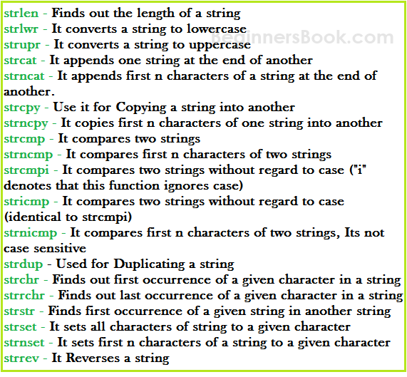
Strings.h in C

Slide 25
Strings in C
C String function – strlen
#include <stdio.h>
#include <string.h>
int main()
{
char str1[] = "structured programming in c";
printf("Length of string str1: %d", strlen(str1));
return 0;
}

Slide 26
Strings in C
C String function – STRUPR()
#include<stdio.h>
#include<string.h>
int main()
{
char str[ ] = "Modify This String To Upper";
printf("%s\n",strupr(str));
return 0;
}

Slide 27
Strings in C
C String function – STRLWR()
#include<stdio.h>
#include<string.h>
int main()
{
char str[ ] = "STRUCTURED PROGRAMMING IN C";
// converting the given string into lowercase.
printf("%s\n",strlwr (str));
return 0;
}

Slide 28
Strings in C
C String function – strcat
It concatenates two strings and returns the concatenated string.
#include <stdio.h>
#include <string.h>
int main()
{
char s1[10] = "Hello";
char s2[10] = "World";
strcat(s1,s2);
printf("Output string after concatenation: %s", s1);
return 0;
}

Slide 29
Strings in C
C String function – strncat()
The strncat() function takes three arguments: dest, src and count. This function appends a maximum of count characters of the string pointed to by src the end of string pointed to by dest. The null terminating character at the end of dest is replaced by the first character of src and the resulting character is also null terminated.
#include <stdio.h>
#include <string.h>
int main()
{
// Take any two strings
char src[50] = "fahad ahmed";
char dest[50]= "Name: ";
// Appends 5 character from src to dest
strncat(dest, src, 7);
printf("Source string : %s\n", src);
printf("Destination string : %s\n", dest);
return 0;
}

Slide 30
Strings in C
C String function – strcmp
It compares the two strings and returns an integer value.
#include <stdio.h>
#include <string.h>
int main()
{
char s1[] = "Fahad";
char s2[] = "Fahad Ahmed";
if (strcmp(s1, s2) ==0)
{
printf("string 1 and string 2 are equal");
}else
{
printf("string 1 and 2 are different");
}
return 0;
}

Slide 31
Strings in C
C String function –STRREV()
reverses a given string
#include<stdio.h>
#include<string.h>
int main()
{
char name[30] = "Hello";
printf("String before strrev( ) : %s\n",name);
printf("String after strrev( ) : %s",strrev(name));
return 0;
}

Slide 32

Thanks to All

